Slide 1

ASYNCTASK

Slide 2





HTTP CONNECTION
ANDROID THREAD
ASYNCTASK DEMO

Slide 3
HttpURLConnection
Obtain a new HttpURLConnection by calling URL.openConnection() and casting the result to HttpURLConnection.
Prepare the request. The primary property of a request is its URI. Request headers may also include metadata such as credentials, preferred content types, and session cookies.

Slide 4
HttpURLConnection
Optionally upload a request body. Instances must be configured with setDoOutput(true) if they include a request body. Transmit data by writing to the stream returned by URLConnection.getOutputStream()
Read the response. Response headers typically include metadata such as the response body's content type and length, modified dates and session cookies. The response body may be read from the stream returned by URLConnection.getInputStream(). If the response has no body, that method returns an empty stream.

Slide 5
HttpURLConnection
Disconnect. Once the response body has been read, the HttpURLConnection should be closed by calling disconnect(). Disconnecting releases the resources held by a connection so they may be closed or reused.
URL url = new URL("http://rss.cnn.com/rss/edition_americas.rss"); HttpURLConnection connect = (HttpURLConnection) url.openConnection(); DataInputStream dis = new DataInputStream(new BufferedInputStream(connect.getInputStream()));
DataOutputStream dos = new DataOutputStream(new BufferedOutputStream(new FileOutputStream(new File("D:\\1.txt")))); int data = 0;
while ((data=dis.read()) != -1) { dos.write(data);
}
dos.flush();
dis.close();
dos.close(); connect.disconnect();

Slide 6

HttpURLConnection
Convert json to object using gson
Add library gson in build.gradle (module)

Slide 7
HttpURLConnection
public static void main(String[] args) throws Exception { URL url = new
URL("https://jsonplaceholder.typicode.com/todos/3");
HttpURLConnection connect = (HttpURLConnection) url.openConnection();
connect.setRequestMethod("GET"); connect.setRequestProperty("User-agent", "Android
App/6.0");
int responseCode = connect.getResponseCode();
if (responseCode == 200){
BufferedReader reader = new BufferedReader(new InputStreamReader(connect.getInputStream()));
String response = ""; String line="";
while ( (line = reader.readLine()) != null){ response = response + line ;
}
Gson gson = new Gson();
User user = (User) gson.fromJson(response,User.class);
System.out.println(user.toString());
}
}

Slide 8
HTTP CONNECTION
ANDROID THREAD
ASYNCTASK HANDLER

Slide 9
ANDROID THREAD
When an application is launched, the system creates a thread of execution for the application, called "main."
This thread is very important because it is in charge of dispatching events to the appropriate user interface widgets, including drawing events.
The main thread is also sometimes called the UI thread.

Slide 10
ANDROID THREAD
The system does NOT create a separate thread for each instance of a component. All components that run in the same process are instantiated in the UI thread,
If everything is happening in the UI thread, performing long operations such as network access or database queries will block the whole UI

Slide 11
ANDROID THREAD
When the thread is blocked, no events can be dispatched, including drawing events
From the user's perspective, the application appears to hang. Even worse, if the UI thread is blocked for more than a few seconds (about 5 seconds currently) the user is presented with the infamous "application not responding" (ANR) dialog. The user might then decide to quit your application and uninstall it if they are unhappy.

Slide 12
ANDROID THREAD
Additionally, the Android UI toolkit is not thread-safe. So, you must not manipulate your UI from a worker thread—you must do all manipulation to your user interface from the UI thread. Thus, there are simply two rules to Android's single thread model:
Do not block the UI thread
Do not access the Android UI toolkit from outside the UI thread

Slide 13
HTTP CONNECTION
ANDROID THREAD
ASYNCTASK HANDLER

Slide 14
ASYNCTASK
Allows you to perform asynchronous work on your user interface.
It performs the blocking operations in a worker thread and then publishes the results on the UI thread
Help you to handle threads and/or handlers instead of doing by yourself

Slide 15
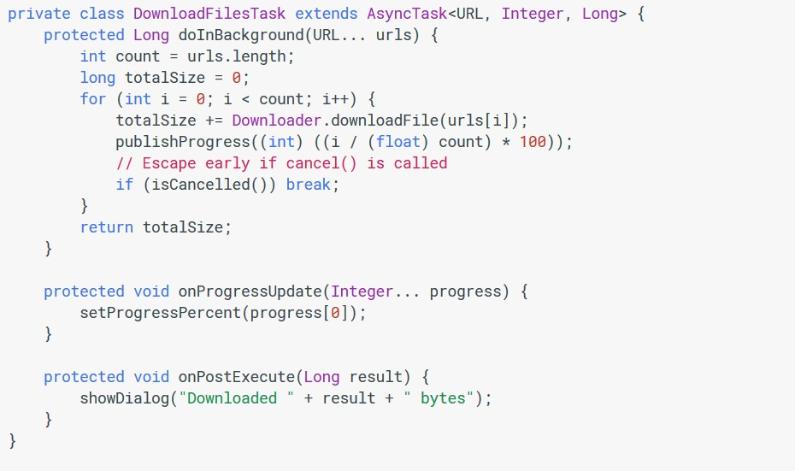
ASYNCTASK EXAMPLE

Slide 16
ASYNCTASK PARAMETER
The three types used by an asynchronous task are the following:
Params, the type of the parameters sent to the task upon execution.
Progress, the type of the progress units published during the background computation.
Result, the type of the result of the background computation.
If parameter not use, just put Void

Slide 17
STEP TO USE ASYNCTASK
Implement the doInBackground() callback method
To update your UI, you should implement onPostExecute(), which delivers the result from doInBackground() and runs in the UI thread
Run the task by calling execute() from the UI thread.

Slide 18
ASYNCTASK RULES
The task instance must be created on the UI thread.
execute(Params...) must be invoked on the UI thread.
Do not call onPreExecute(), onPostExecute(Result), doInBackground(Params...), onProgressUpdate(Progress...) manually.
The task can be executed only once (an exception will be thrown if a second execution is attempted.)

Slide 19
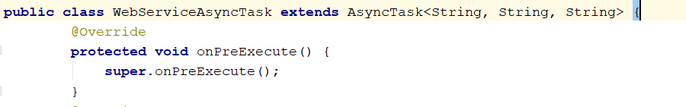
ASYNCTASK EXAMPLE
Extends AsyncTask class

Slide 20
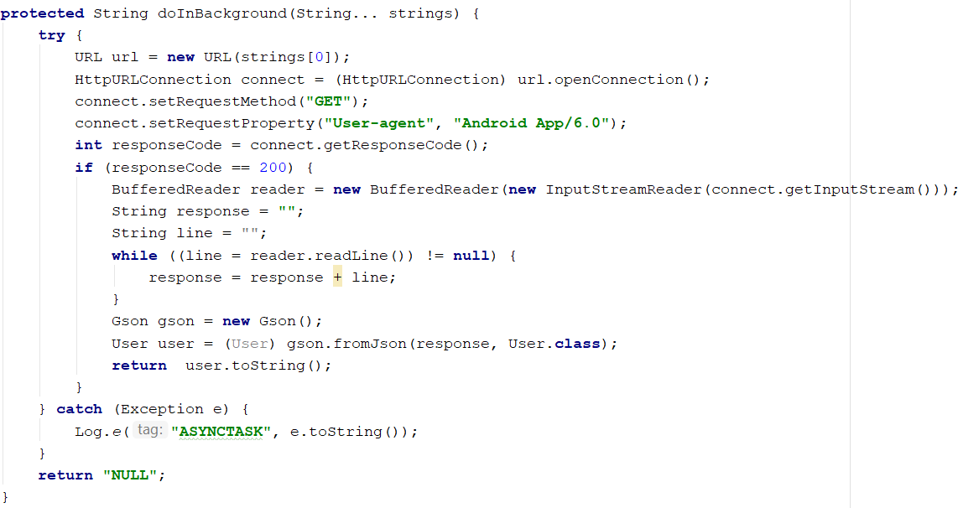
ASYNCTASK EXAMPLE
Implement doInBackground()

Slide 21

ASYNCTASK EXAMPLE
Implement onPostExecute()

Slide 22
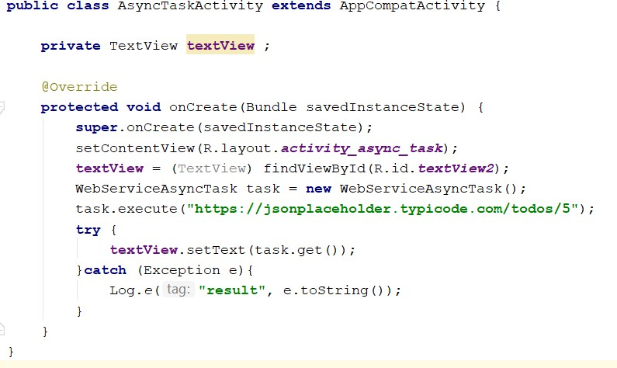
ASYNCTASK EXAMPLE
Call execute() in UI thread

Slide 23
QUESTION
&
THANK YOU FOR YOUR ATTENTION

